Slide 1


Chowgacha-Jhenaidah model is the best example of community participation
Dr. Md.Emdadul Haque
Senior National Consultant
C-J Model Replication Committee

Slide 2
Comparative data of health facilities of different country of the world
SL NO | Country | Per capita health Expenditure per year by Govt. ($) | Doctors per 10000 Population | Nurse per 10000 Population | Beds per 10000 population | Out of pocket expenditure
01 | USA | 10246 | 29 | 119 | 29 | 11.08
02 | UK | 3860 | 28 | 82 | 25 | 14.79
03 | Malaysia | 384 | 15 | 35 | 19 | 36.67
04 | Sri Lanka | 159 | 10 | 21 | 41 | 38.43
05 | India | 69 | 7. | 17 | 5.3 | 65.06
06 | Nepal | 48 | 7.5 | 31 | - | 60.41
07 | Pakistan | 45 | 9.8 | 7 | 8 | 66.49
08 | Bangladesh | 37 | 5.3 | 4 | 8 | 67
World Bank 2018

Slide 3





CHOWGACHA UHC-Through the Ages
Old UHC
Old UHC
31-bedded UHC
50-bedded UHC

Slide 4
A Hospital with a Vision …
Maximum utilization of Govt.
resources with
honesty and sincerity.
Integrated approach of
Administration, Community
Leaders .
Providing Effective services
through improved
management system.

Slide 5
Background History of MCH services of Chowgacha Health Complex, Jessore
To reduce Maternal and Child Mortality and Mobility and to ensure the quality services to the mother and child, UHFPO opened 4 special activities headed by medical officers in Feb. 1996. And from January 1995 to 1997 JICA helped us by Frontline MCH Program to implement the program by giving technical and logistic supports. Since 1998 DGHS & UNICEF have continued the support.
<4 Special activities>
ANC-Corner
Basic EOC service
Under 5 corner for under 5 children
Monthly birth and death record

Slide 6
Background History Contd.
Dec. 1999 – DGHS & UNICEF provides logistic & Anaesthesia Trg.
November 2000 started Comprehensive EOC program
2004—2014 - the UHC was awarded by the Bangladesh Government and UNICEF for best performance on EOC Service.
August 2006-Safe Blood Transfusion unit established with the aid of UNICEF.
April 2007-Demand Side Financing (DSF) program started.
Women friendly Hospital declared in 2008.
Hospital declared as model health complex on 20 June 2008 and upgraded to 50 bedded hospital by Secretary of Ministry of Health & family welfare.
“Chowgacha health complex Model is replicable through out the country” Declared by Dr. Margaret Chan, D.G. WHO on 8th March 2010.

Slide 7





Slide 8

Upazila Health Complex
CHOWGACHA , JESSORE.
EOC Activities : 1997- 2011 (Hospital Delivery )

Slide 9

Upazila Health Complex
CHOWGACHA , JESSORE.
EOC Activities : 2000 - 2011 (Caesarian Section)

Slide 10
EOC Activities : 2011- 2020 (Total Hospital Delivery & C-section )

Slide 11
Upazila Health Complex
CHOWGACHA , JESSORE.
Comparative Data of Delivery of best performing EOC center of Khulna Division in 2011
SL No | Name of institute | NVD | Vacuum Del. | V. Breech | C. Section | Total
01. | Chowgacha UHC | 3346 | 34 | 26 | 1007 | 4413
02. | Ad-din Hospital Jessore. | 1124 | 0 | 0 | 1864 | 3492
03. | Khulna Medical College Hospital | 1581 | 58 | 18 | 1356 | 3013
04. | 250 bed Hospital, Jessore | 1327 | 2 | 25 | 1498 | 2852
05. | 250 bed Hospital, Kustia | 1728 | 0 | 34 | 915 | 2677

Slide 12
Emergency + Outdoor & Indoor 2011-2020
UHC Chowgacha

Slide 13
Bed Occupancy Rate (in percentage) of Chowgacha UHC

Slide 14
EOC Activities Chowgacha UHC 2011-2020
EOC Activities : 2011 – 2020 (ANC First Visit)

Slide 15
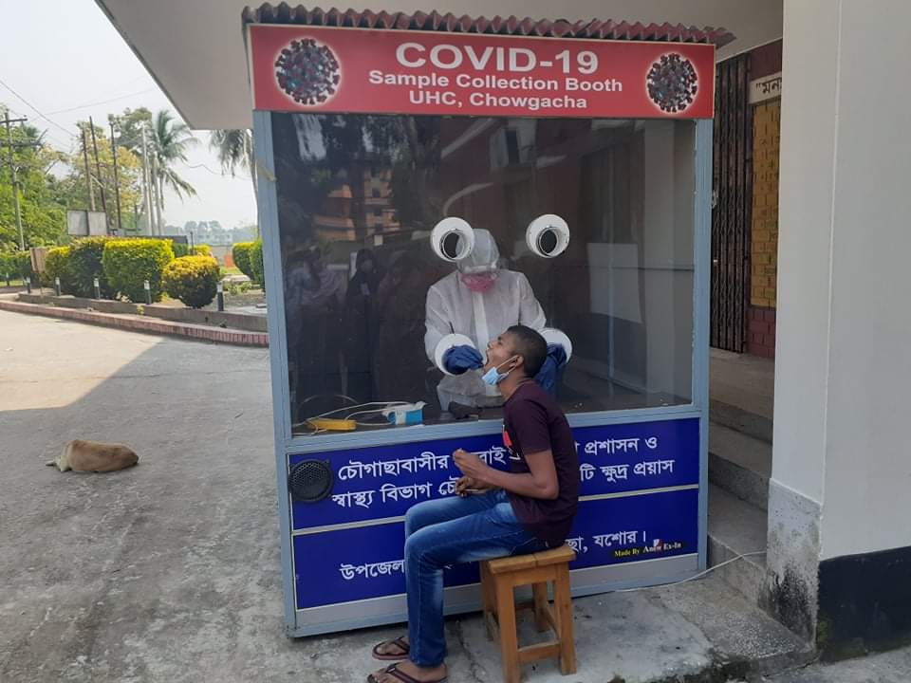
COVID-19 Response of UHC Chowgacha
COVID-19 Sample Collection
 | NUMBER | COMMENT
Total Specimen Collected | 1341 | Upto 31/05/2021
Total Detected Patient | 213 | Upto 31/05/2021
Death | ০3 | Upto 31/05/2021
Affected Healthcare workers | 27 | Upto 31/05/2021

Slide 16
Upazilla Health Complex
CHOWGACHA , JESSORE.
COMMUNITY SUPPORTED MANPOWER
TOTAL :46
  Volunteers :26
  Cleaners & guards :16
  Others :04
  The remunerations come from
  Outsourcing :25
  Service provider :21
  The amount of remuneration ranging from 200/= To 8000/=tk. Per month depending upon the style of work, which costs a total of nearly 90,ooo/=Tk per month.

Slide 17
Reason why Chowgacha Health Complex is Model-1
Successful leadership in health management
All the Components of Primary Health Care are successfully implemented here
Personal and group skills in health care
Community engaged health management
Optimum use of government resources
Effective relation with local administration and with other government organizations
Improvement of security by community engagement
Improved maternal and child health care activities
Ensuring corner-based health care
Woman and Baby Friendly Hospital.

Slide 18
Reason why Chowgacha Health Complex is Model-2
Birth and death recording, progress assessment and accountability by collecting information on all health indicators
Improving healthcare by unit management
Health awareness by health education in outdoor, indoor, ante-natal registration room and pregnant women restroom
Cleanliness (Waste management) and beautification of the facility and premises
Provision of safe blood transfusion for emergency needs
Zero tolerance against corruption
Implementation of the 5S KAIZEN-TQM for the improvement of health care
Improved financial management by establishing cash counter

Slide 19






Slide 20
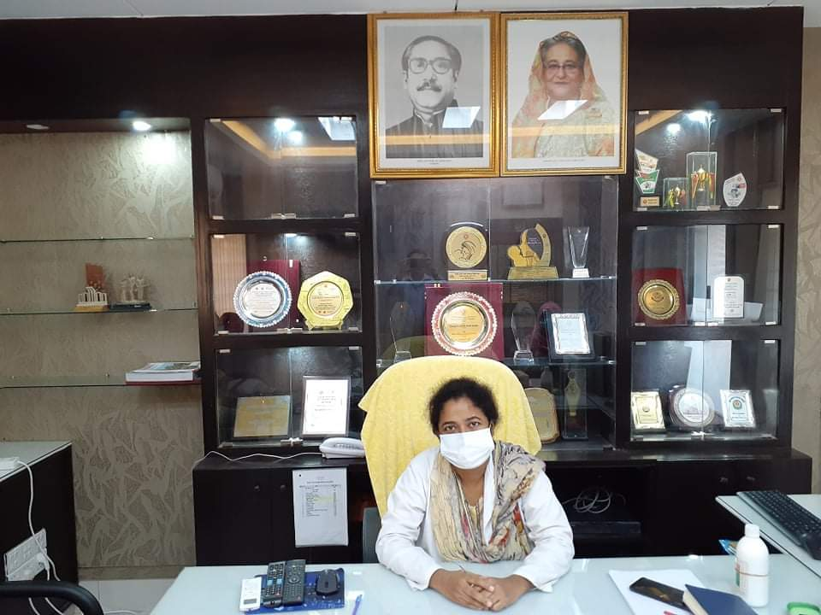
ACHIEVEMENTS of CHOWGACHA HEALTH COMPLEX
In 2008, Chowgacha Health Complex declared as the Model Upazilla Health Complex
  EOC Beds increased from 11 to 41
  Chowgacha UHC achieved MDG target in 2009
  Chowgacha UHC became the Best EOC center with 98.4% delivery rate in 2011
  Chowgacha Health complex is awarded for best performance in EOC form 2005 to 2014
  Achieve Health Ministers Award for its best performances in 2017 and 2018
  The UHC starts upgrade to 100 bedded hospital
  The UHC model is being replicated throughout the country by MOH & FW and DGHS since 2016 by the order of Prime Ministers office

Slide 21

100 kh¨v wewkó m`i nvmcvZvj, wSbvB`n

Slide 22

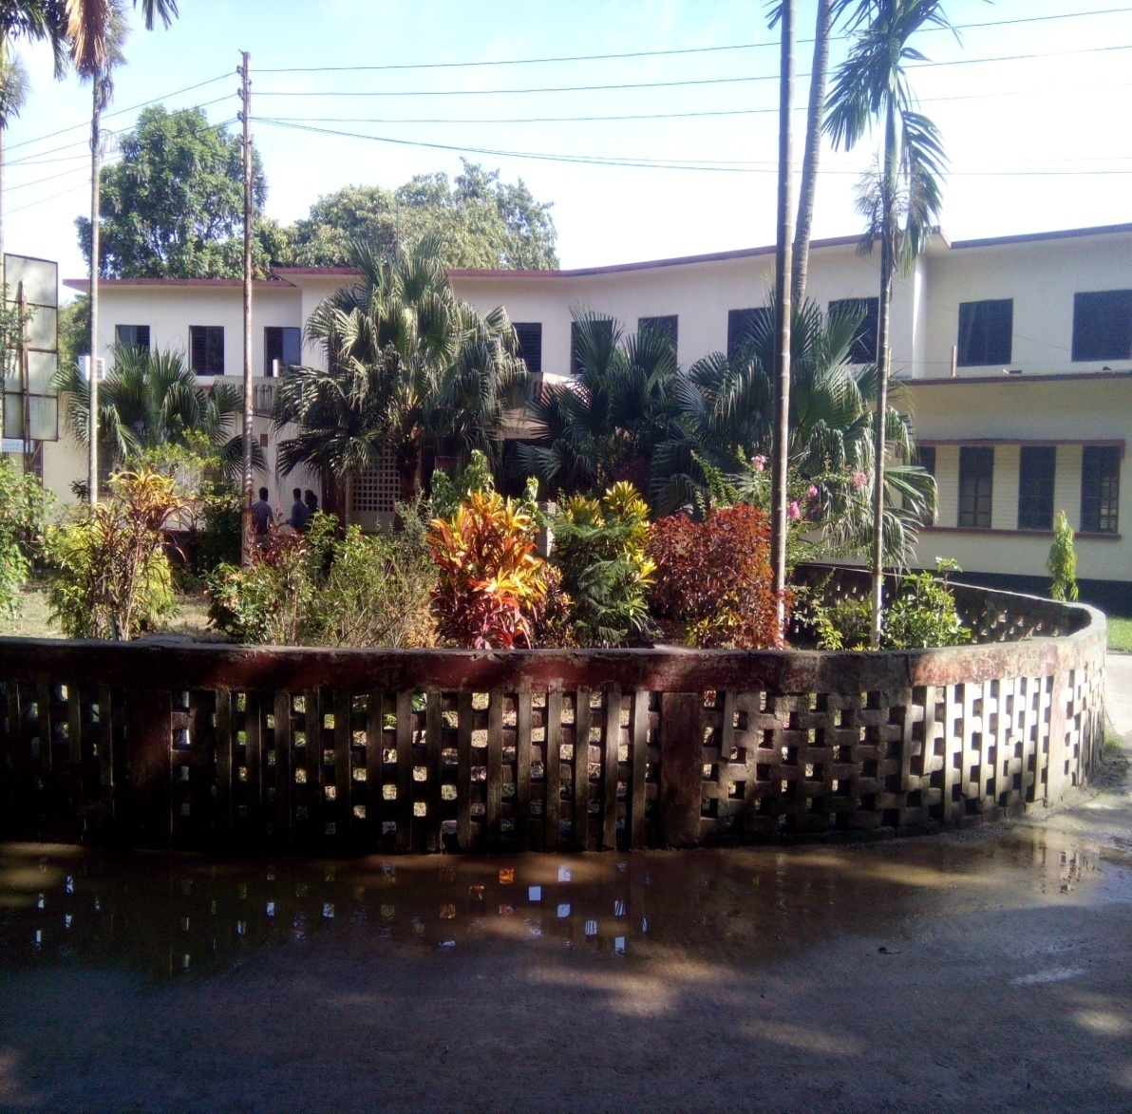

সদর হাসপাতাল,ঝিনাইদহ
পুরাতন ভবন - ১০০ শয্যা
নতুন ভবন ২৫০ শয্যা হাসপাতাল, ঝিনাইদহ

Slide 23
Challenges of the hospital in 2012
Insecure hospital environment.
Performance of all activities was very low.
Very limited support staff.
Receiving money from the patients by non-gov. staff.
Waste management system was poor.
Monitoring meeting was not performed regularly

Slide 24

Sadar Hospital, Jhenaidah
Bed Occupancy Rate from 1998 to 2020

Slide 25


Emergency + Out Door & Indoor Service 1998 to 2020
Emergency + Outdoor visit, Indoor (admission)

Slide 26
Operation Service (Major) 2011 to 2020
Sadar Hosital, Jhenaidah

Slide 27
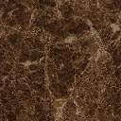
Sadar Hospital, Jhenaidah
Admitted Under 5 children in indoor from 2014 to 2020

Slide 28
Total ANC and Delivery in Jhenaidah District Hospital 2011-2020

Slide 29
Comparative data of revenue income (in Taka) from 2015 to 2020
Sadar Hospital, Jhenaidah

Slide 30
Comparative data of 4 best performing EOC Centre of Khulna division 2019

Slide 31
Covid-19 Admitted Patient Report 7/5/20 to 12/06/2021
Total possitive Jhenaidah District - 3037

Slide 32
Community Support System in Sadar Hospital
58 manpower (Cleaner 26, Ayah & ward boy 22, Guard 5, Volunteer 2, Trolley man 3 ) is supported by the community.
MP of Jhenaidah-2 donated 19 manpower support.
Chairman of Zah edee foundation supports 12 manpower and an intercom with a cost of nearly two lac taka.
Mayor of Jhenaidah Paurasava plays an important role in security , cleanliness, repaired the boundary wall and supports 5 man power and renovation of pediatric word and donation of a biochemistry analyzer at a cost of 1,15,000 Taka.
Former-chairman of Jhenidah Pourosova supports 2 manpower
Doctors of the hospital and Jhenaidah town supports 17 man power.
Different kind of instruments donated by community leaders in covid-19 situation .(About 7000000 taka)

Slide 33




Visit to Shatkhira District Hospital and Introduction of TQM activities

Slide 34




Changes in EOC Ward
Before
After
Before
After

Slide 35








Changes in Surgery & Pediatric Word

Slide 36




Waste Management & Campus Protection
Before
After
Before
After

Slide 37




Use of color code, alignment of picture & continuous big cleaning day
Color code
Color code
Alignment of pictures

Slide 38




Use of direction sign, labeling of rooms, clean latrine and waste segregation
Use of direction sign
Labeling of rooms
waist segregation
Clean latrine

Slide 39
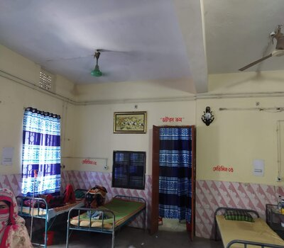
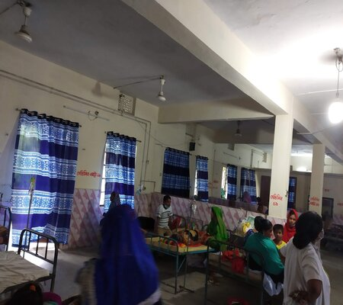
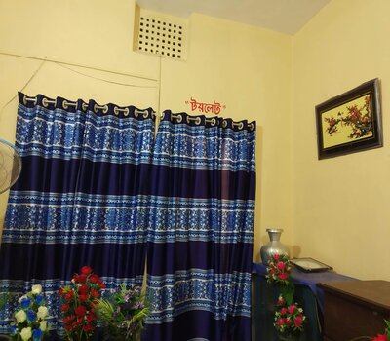
Female Medicine Ward

Slide 40



Innovation Male Medicine Ward

Slide 41




Innovative activities of Jhenaidah Sadar Hospital - 1
Reception room
Creation of nursing aid
Health education session
Community engagement

Slide 42




Innovative activities of Jhenaidah Sadar Hospital - 2

Slide 43




Innovative activities of Jhenaidah Sadar Hospital - 3

Slide 44




Innovative activities of Jhenaidah Sadar Hospital - 4

Slide 45




Innovative activities of Jhenaidah Sadar Hospital - 5

Slide 46




Involvement of MP, District Administrator & Mayor in Sadar Hospital

Slide 47




Involvement of district high officials in hospital activities

Slide 48




Internal Monitoring System
Meting of health improvement committee
Meting of community support group committee
QIC meeting
Monthly meeting schedule

Slide 49




Improved pediatric word by local initiative

Slide 50

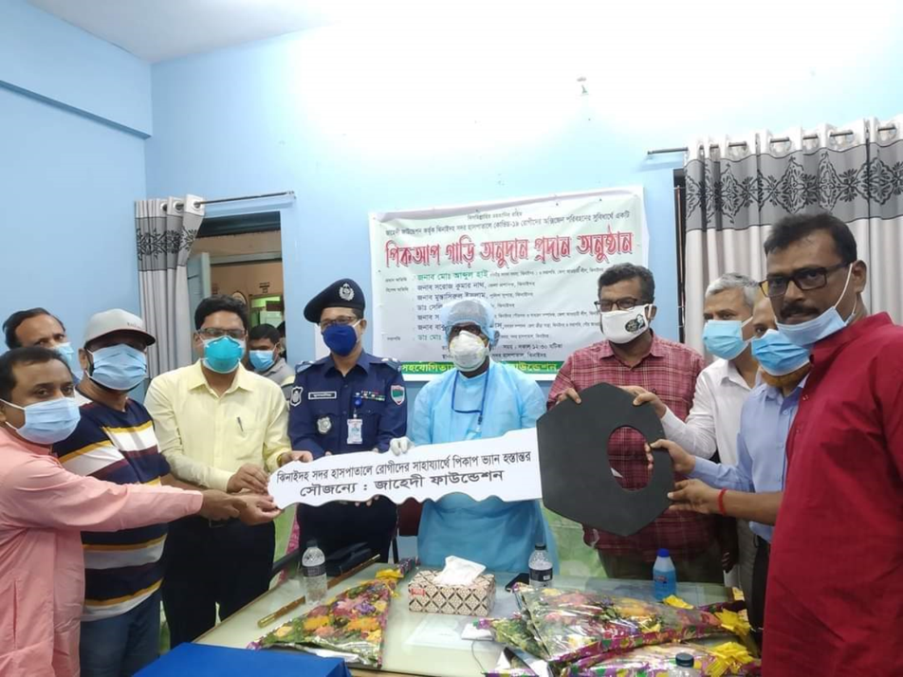



Slide 51
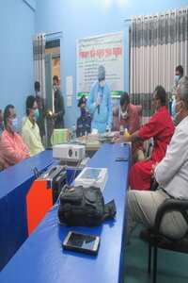
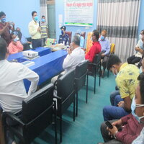


জাহেদী ফাউন্ডেশন কর্তৃক পিকআপ ভ্যান প্রদান

Slide 52
Achievement of the Hospital
1. Active Community Participation in health service is an example in Bangladesh.
2. Improved performance of all services specially Pediatric, obstetric, operation
and outdoor service.
3. Improved Cleanliness and Beautification of Campus.
4.. The hospital is awarded 6 times from 2013 to 2018.
5. Improved Security.
6. Improved Financial Management
7. Replication of C- J Model by DGHS in 20 District hospital & 40 UHC of the country.
8. Nearly 45 laks Taka support for 6 high flow oxygen nasal cannula, central oxgen supplying system for covid patient

Slide 53

HSSI Health Minister’s National Award 2019

Slide 54

Thank You
আমাদের বাগানের ফুল
Notes:
54

